Slide 1
AI
Session9
Aakash Goel

Slide 2
Basics of Neural Network
What is a Neural Network
Neural Network Classifier
Data Normalization
Neuron and bias of a neuron
Single Layer Feed Forward
Limitation
Multi Layer Feed Forward
Back propagation

Slide 3
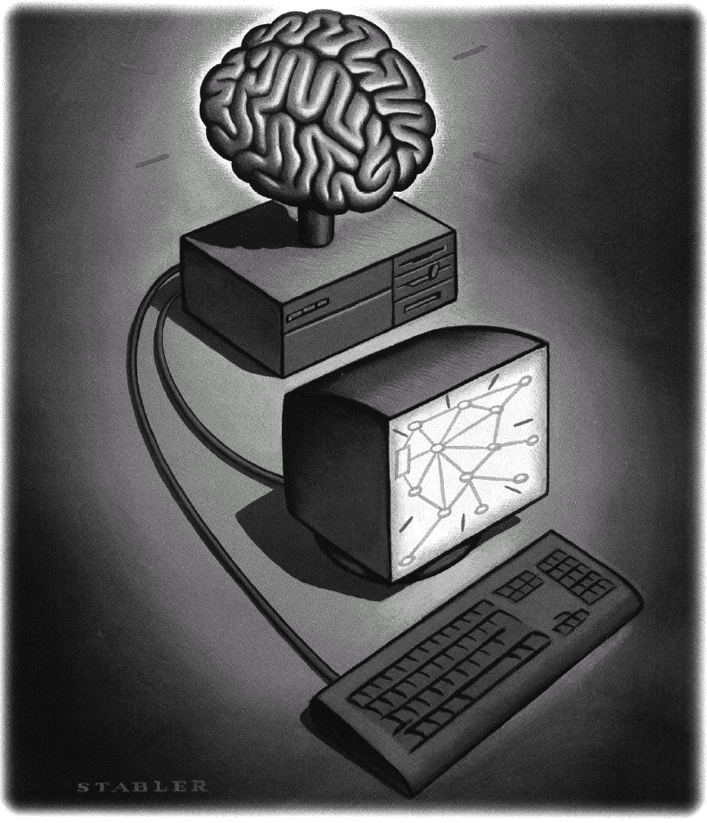
Neural Networks
What is a Neural Network?
Biologically motivated approach to machine learning
Similarity with biological network
Fundamental processing elements of a neural network is a neuron
1.Receives inputs from other source
2.Combines them in someway
3.Performs a generally nonlinear operation on the result
4.Outputs the final result
Courtesy: Stony Brook University

Slide 4
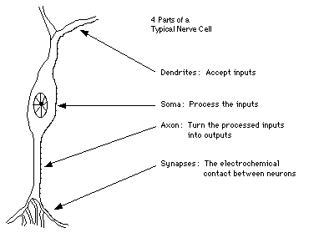
Similarity with Biological Network
Fundamental processing element of a neural network is a neuron
A human brain has 100 billion neurons
An ant brain has 250,000 neurons
Courtesy: Stony Brook University

Slide 5
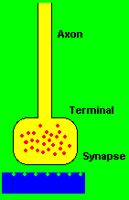
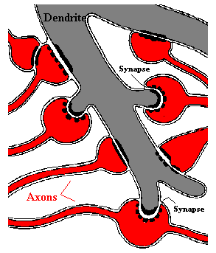
Synapses, the basis of learning and memory
Courtesy: Stony Brook University

Slide 6
Neural Network
Neural Network is a set of connected
INPUT/OUTPUT UNITS, where each connection has a WEIGHT associated with it.
Neural Network learning is also called CONNECTIONIST learning due to the connections between units.
It is a case of SUPERVISED, INDUCTIVE or CLASSIFICATION learning.
Courtesy: Stony Brook University

Slide 7
Neural Network
Neural Network learns by adjusting the weights so as to be able to correctly classify the training data and hence, after testing phase, to classify unknown data.
Neural Network needs long time for training.
Neural Network has a high tolerance to noisy and incomplete data
Courtesy: Stony Brook University

Slide 8
Neural Network Classifier
Input: Classification data
It contains classification attribute
Data is divided, as in any classification problem.
[Training data and Testing data]
All data must be normalized.
(i.e. all values of attributes in the database are changed to contain values in the internal [0,1] or[-1,1])
Neural Network can work with data in the range of (0,1) or (-1,1)
Two basic normalization techniques
[1] Max-Min normalization
[2] Decimal Scaling normalization
Courtesy: Stony Brook University

